Slide 1
Key Challenges of Talent Retention
Daisy Xu
InSight Data Technologies
May 2016

Slide 2
Key Challenges of Talent Management
Generation Gap
High Turnover
Lost track of exits

Slide 3
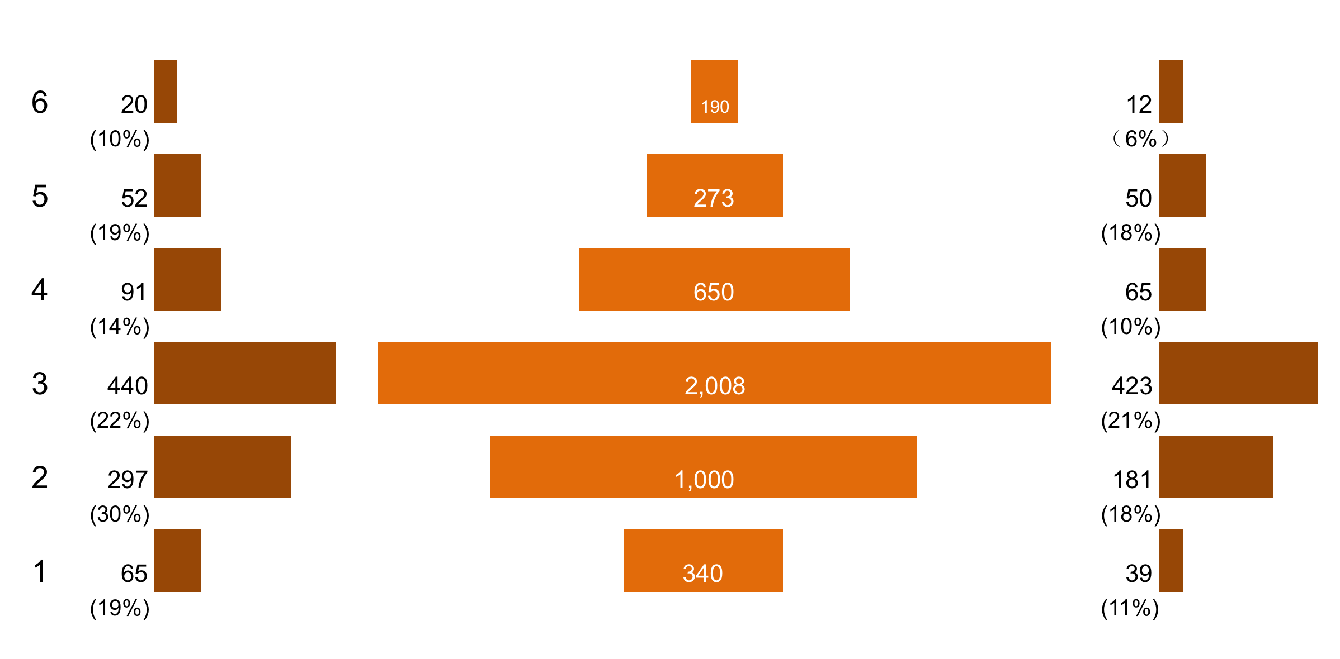
Internal Labour Market
Grade
Hires
Total Employees
Exits
5%
12%
6%
17%
11%

Slide 4
Exit reasons
Exit Reasons (Management vs Professional)
%

Slide 5
Read employee minds
党派之争严重
43%
工作流程繁琐
38%
无效率
内部沟通成本太高
管理层不作为
26%
赏罚不分明
人浮于事
加班太多
35%
老板用人不公正
团队气氛不好

Slide 6
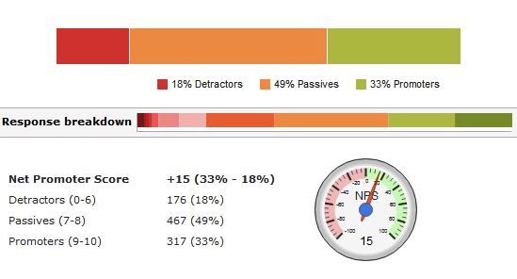
Alumni Promoter Score
Alumni Promoter Score is the most efficient way of measuring exit employee’s rating on the employer brand.
18% Detractors
49% Passives
33% Promoters
Response Breakdown
答案细分
My APS
+15 (33%-18%)
Detractors (0-6)
Passives (7-8)
Promoters (9-10)
176 (18%)
467 (49%)
317 (33%)
Industry Rank: 3rd I Average: +8

Slide 7
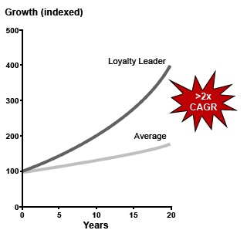
APS drives the financial performance
Studies show APS highly correlates the financial performance of a company.
Financial growth
High performers with APS
Average
Source：Bain&Co.

Slide 8
Case Study: Alumni Tracker (Accenture)
Alumni Website of Accenture.
Rehire
Refer

Slide 9
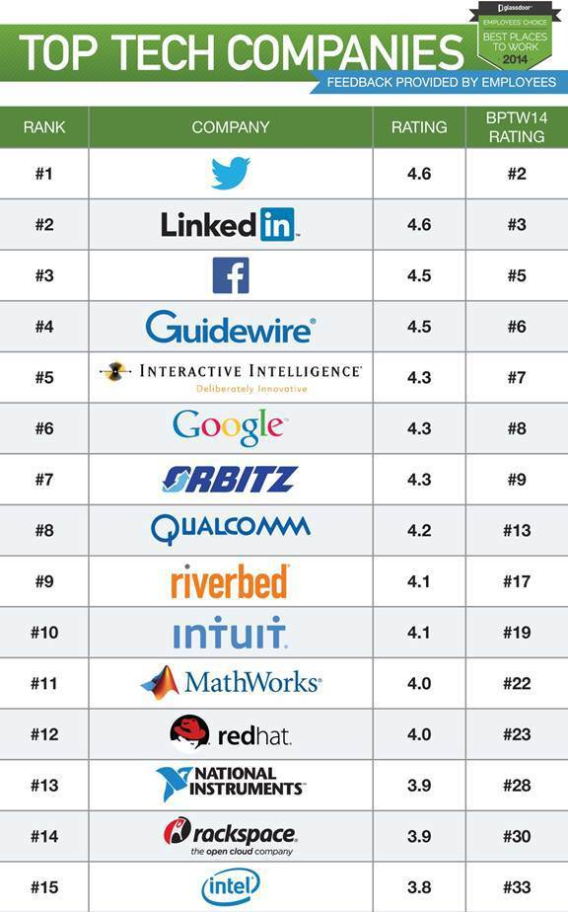
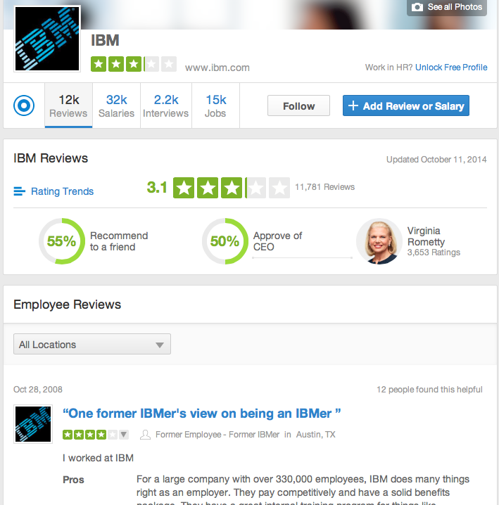
Case Study: glassdoor
Employer Brand Opinion Poll through social network

Slide 10
Case Study: AfterWork social network
AfterWork is a social platform that connect professionals by common interest, profession, location, etc. Join an event, and find a community.
MeetUp for Chinese Professionals
Join an event
Find a community

Slide 11
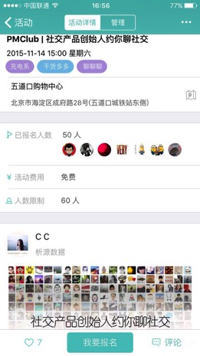
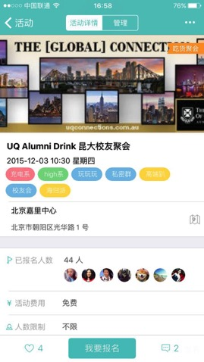
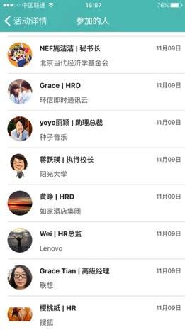
We have organized more than 2000 social events for professionals in Beijing

Slide 12
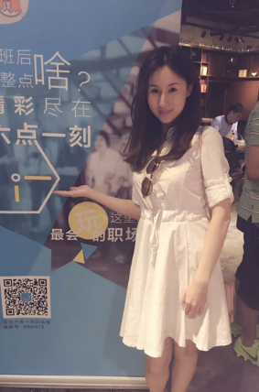
Mix up of young professionals and veteran
Big Data Scientists
Young professionals：
They are eager to learn
Curious
Wants to connect with others
Good education background, most often from overseas and MNC
Veteran
Share
A slash profession
Looking for professional change
HR professionals
Product Managers

Slide 13
See you after work!
Daisy Xu
Founder & CEO
Mobile:137 0136 2991
Wechat: daisyxu2014

